Slide 1
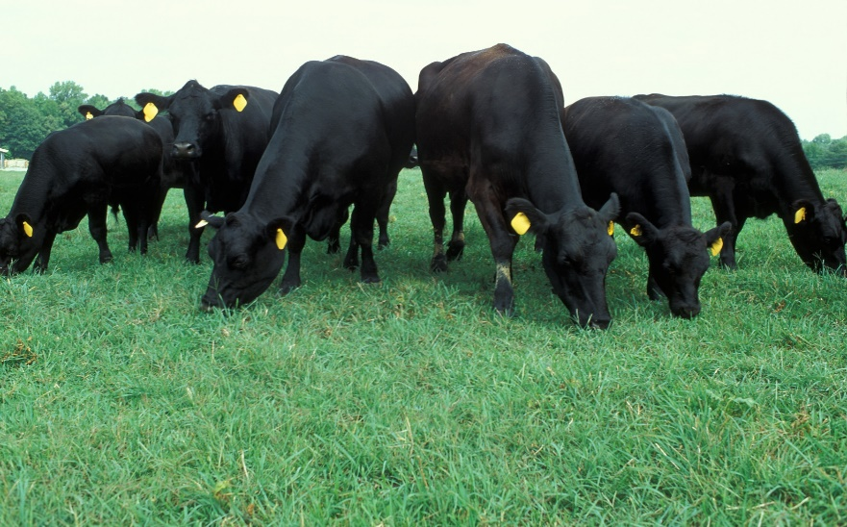
Virginia Animal Entry Permit System
Beginning June 1, 2019, accredited veterinarians responsible for certifying the health status of cattle, bison and other bovines being shipped to the Commonwealth of Virginia must obtain an entry permit. An online animal entry permit system is available at no cost for accredited veterinarians to submit required information and obtain an entry permit. Alternatively, veterinarians may submit an electronic Certificate of Veterinary Inspection (eCVI) from an approved commercial application. Currently, only eCVI submissions from AgView or Global VetLink are approved. Additional information is provided below
There is no cost to use the Virginia Animal Entry Permit system.
At present, a permit is required only for CATTLE being IMPORTED to Virginia.
Accredited (Type 2) veterinarians, please go to https://www.statevet.com/ to signup for an account. Once approved by our staff, you will be able to log-in and create an entry permit.
An electronic copy (PDF format) of the entry permit will be available once the application is complete and submitted. Please do not send this document to us; as soon as the permit is submitted online the information will be transferred to our office electronically.
This information will also be sent to the State Veterinarian’s Office in the state of origin. If you have concerns about this process in your state, please contact your state veterinarian to see if a paper CVI is still required.
Virginia requires individual official identification for all cattle, except beef feeder cattle under 18 months of age. Official identification means an 840-series (electronic RFID tags highly preferred) or USDA metal ear tag (orange brucellosis or silver brite tag). Brands, tattoos or other types of identification are not considered official ID in Virginia.
If you have questions or need assistance using the permit system, please contact us Monday-Friday, 8:00am to 4:00pm EST.
Rick Odom | Brandy Connelly | Dr. Abby Sage
804.692.0600 | 804.786.2483 | 804.786.2483
richard.odom@vdacs.virginia.gov | brandy.connelly@vdacs.virginia.gov | abby.sage@vdacs.virginia.gov

